Slide 1
Chapter 7
Data Collection Methods: Introduction and Interviews
1

Slide 2

Week 07 Data Collection Methods:
Masters of Information Systems & Technology
MIS 6220 RESEARCH METHODS
_{BY}
Prof. Jimmy K.N.Macharia,
Associate Professor of Information Systems &Technology, and
Dean, School of Science & Technology,
_{kmacharia@usiu.ac.ke}

Slide 3
Data Collection Methods:
Introduction and Interviews
Observation
Questionnaires

Slide 4
Sources of Data
Primary data: information obtained ﬁrsthand by the researcher on the variables of interest for the specific purpose of the study.
Examples: individuals, focus groups, panels
Secondary data: information gathered from sources already existing.
Examples: company records or archives, government publications, industry analyses offered by the media, web sites, the Internet, and so on.

Slide 5
Interviews
Unstructured interviews:
the interviewer does not enter the interview setting with a planned sequence of questions to be asked of the respondent.
Structured interviews:
Conducted when it is known at the outset what information is needed.
The interviewer has a list of predetermined questions to be asked of the respondents either personally, through the telephone, or via the computer.

Slide 6
Personal interview
Advantages
Can clarify doubts about questionnaire
Can pick up non-verbal cues
Relatively high response/cooperation
Special visual aids and scoring devises can be used
Disadvantages
High costs and time intensive
Geographical limitations
Response bias / Confidentiality difficult to be assured
Some respondents are unwilling to talk to strangers
Trained interviewers

Slide 7
Telephone interview
Advantages
Discomfort of face to face is avoided
Faster / Number of calls per day could be high
Lower cost
Disadvantages
Interview length must be limited
Low response rate
No facial expressions

Slide 8
Self-administered
Advantages
Lowest cost option
Expanded geographical coverage
Requires minimal staff
Perceived as more anonymous
Disadvantages
Low response rate in some modes
No interviewer intervention possible for clarification
Cannot be too long or complex
Incomplete surveys

Slide 9
Projective Methods
Word association techniques:
Asking the respondent to quickly associate a word with the first thing that comes to mind.
Often used to get at true attitudes and feelings.
Thematic apperception tests (TAT):
Call for respondent to weave a story around a picture that is shown.
To trace patterns and personality characteristics of respondents.
Inkblot tests:
Form of motivational research, uses colored inkblots that are interpreted by respondents.

Slide 10
Chapter 8
Data Collection Methods: Observation
10

Slide 11
Observation
Observation involves going into ‘the field’, - the factory, the supermarket, the waiting room, the office, or the trading room - watching what workers, consumers, or day traders do, and describing, analyzing, and interpreting what one has seen.

Slide 12
Examples
Shadowing a Wall Street broker engaged in his daily routine.
Observing in-store shopping behavior of consumers via a camera.
Sitting in the corner of an office to observe how a merchant bank trader operates.
Working in a plant to study factory life.
Studying the approach skills of sales people disguised as a shopper.

Slide 13
Key dimensions characterizing type of observation
Controlled versus Uncontrolled Observational Studies
Participant versus Non-Participant Observation
Structured versus Unstructured Observational Studies
Concealed versus Unconcealed observation

Slide 14
Participant Observation
The participatory aspect:
Complete participation
Moderate participation
Active participation
To what extent should I participate?

Slide 15
Participant Observation
The observation aspect
Obtaining permission
Finding a ‘sponsor’
Establishing rapport

Slide 16
What to observe?
Descriptive observation stage:
Space
Objects
Actors
Feelings
Events
Spradly, 1980

Slide 17
What to observe?
Focused and selective observation stage:
Look for a story line
Sort out regular from irregular activities
Look for variation in the storyline
Look for negative cases or exceptions
Develop a plan for systematic observation if needed
DeWalt and DeWalt, 2002

Slide 18
Structured observation
Looks selectively at predetermined phenomena
Different levels of structure

Slide 19
Coding schemes
Focus
Objective
Ease of use
Mutually exclusive and collectively exhaustive

Slide 20
Standard Coding Schemes
Simple checklist
Sequence record
Sequence record on time scale

Slide 21
Chapter 9
Data Collection Methods: Questionnaires
21

Slide 22
Questionnaire Design
Definition
A questionnaire is a pre-formulated, written set of questions to which the respondent records his answers
Steps
Determine the content of the questionnaire
Determine the form of response
Determine the wording of the questions
Determine the question sequence
Write cover letter

Slide 23
1. Questionnaire content
Framework
Need information for all constructs in framework
Measurement: Operationalizing
Objective construct:
1 element/items
=> 1 question
Subjective construct:
multiple elements/items
=> multiple questions

Slide 24
2. Response format
Closed vs. Open-ended questions
Closed questions
Helps respondents to make quick decisions
Helps researchers to code
Open-ended question
First: unbiased point of view
Final: additional insights
Complementary to closed question: for interpretation purpose
Cfr. Measurement: Response scales

Slide 25
3. Question wording
Avoid double-barreled questions
Avoid ambiguous questions and words
Use of ordinary words
Avoid leading or biasing questions
Social desirability
Avoid recall depended questions

Slide 26
Question wording
Use positive and negative statements
Dresdner delivers high quality banking service
Dresdner has poor customer operational support
Avoid double negatives
Limit the length of the questions
Rules of thumb:
< 20 words
< one full line in print

Slide 27
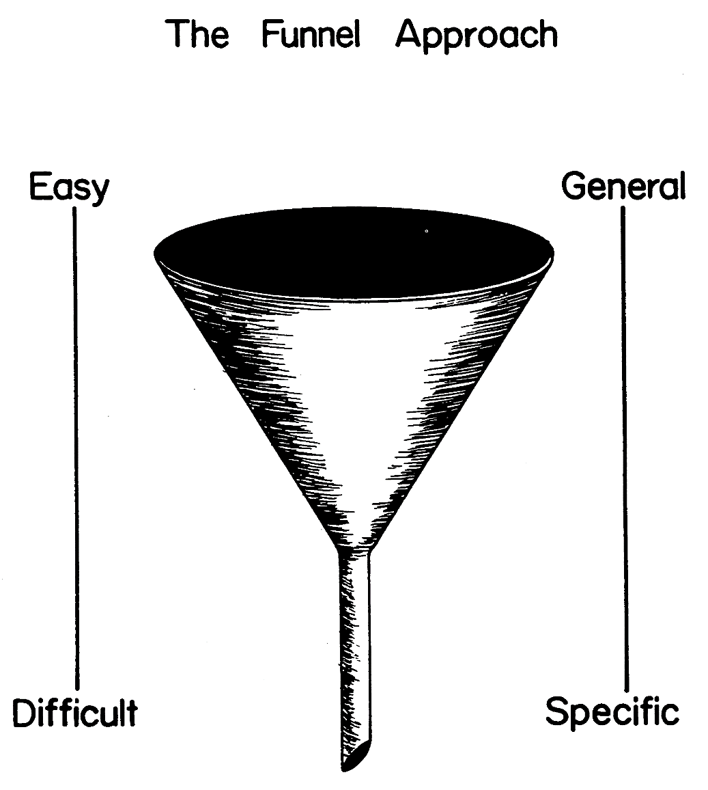
4. Question sequence
Personal and sensitive data at the end

Slide 28
5. Cover letter
The cover letter is the introductory page of the questionnaire
It includes:
Identification of the researcher
Motivation for respondents to fill it in
Confidentiality
Thanking of the respondent

